Slide 1
TECHNICAL COLLEGE
”MARCEL GUGUIANU”
ZORLENI -VASLUI COUNTY - ROMANIA

Slide 2
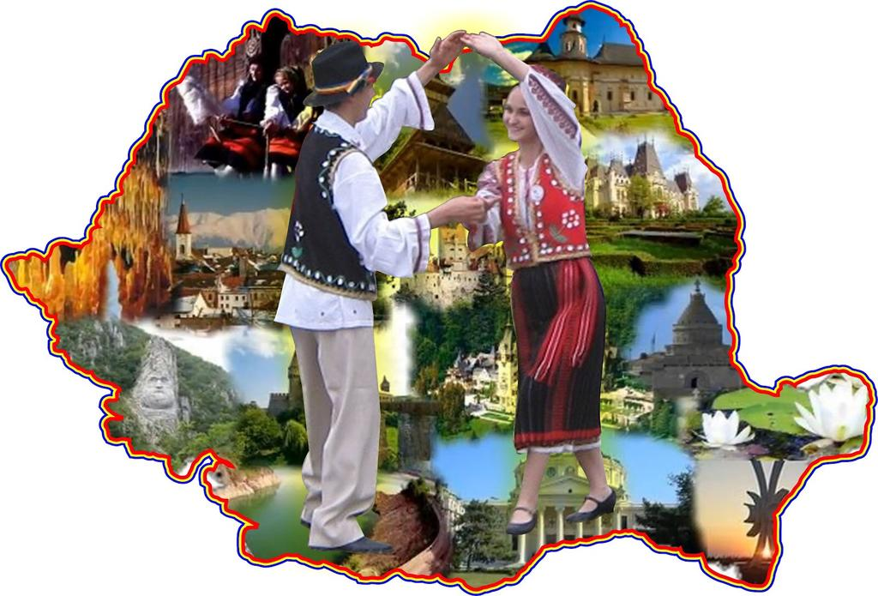
Romania
Notes:
Faded zoom

Slide 3
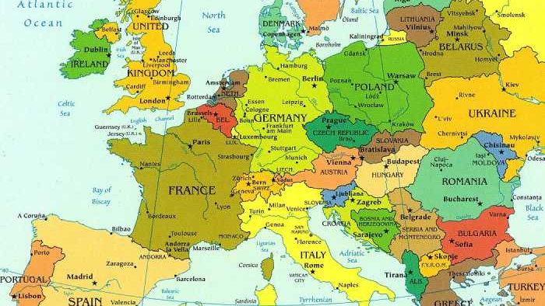
Poland
Romania

Slide 5
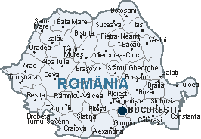
Romania
- Romania is a South-Eastern country of Europe, with a population of almost 19,000,000 and an area of 237,500 square kilometers.
- The capital of Romania is Bucharest.
Bucharest

Slide 6
General information
- Since 1918, the national day of Romania is on the 1st of December, the day when the 3 parts (Transylvania, Moldavia, Valachia ) that once were apart came together and formed the country as it is today.
- The official language is Romanian, a Neolatin language, being related to the other Latin languages in Europe, such as Italian, Spanish, French etc.

Slide 7
General information
-The main creed in Romania is the Orthodoxism (around 87% of the population), followed by Catholicism (5% of the population) and others.
-The official currency in Romania is the ’Lei’, but it’s usual that the banks and other institutions work with the USD or with the Euro (the official currency for most of the countries in Europe).

Slide 8
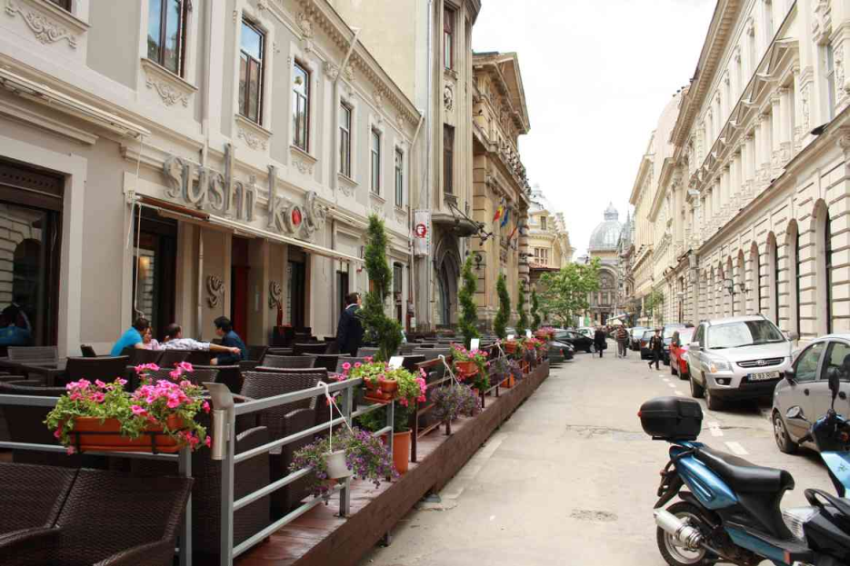
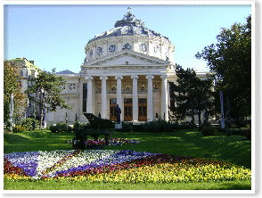
Bucharest- The capital of Romania
The capital of Romania is Bucharest, one of the most beautiful cities in the country, situated in the Southern part of Romania. Bucharest is also called "little Paris", because of the many French influences of the last century, when the most spoken foreign language in Romania was French.
Old Bucharest Center
Romanian Athenaeum

Slide 9
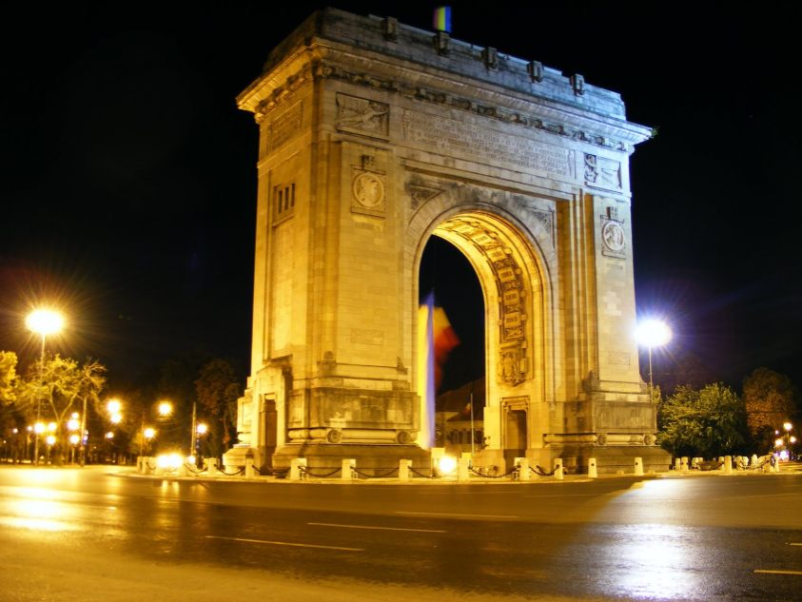
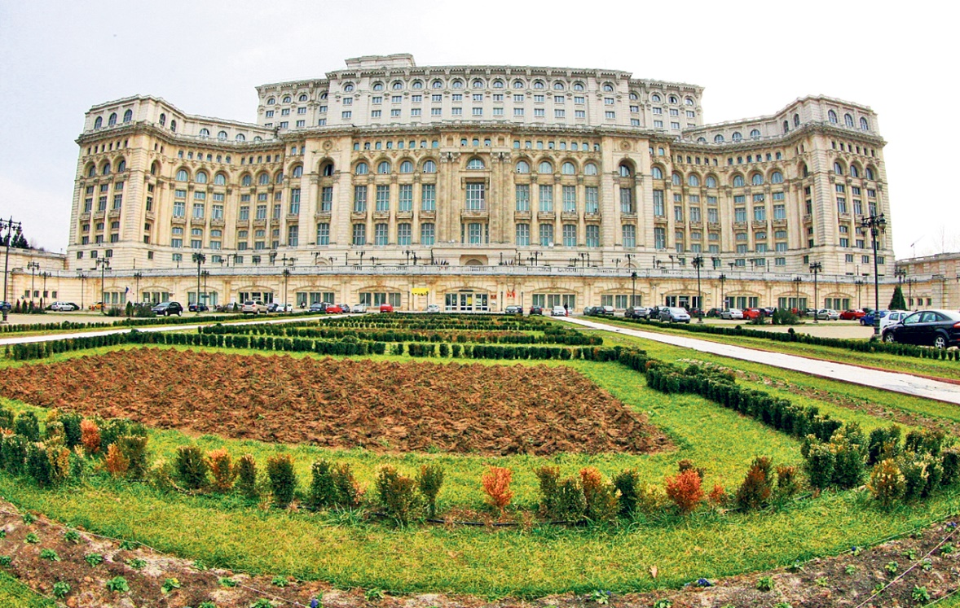
Arch of Triumph
Parliament House

Slide 10
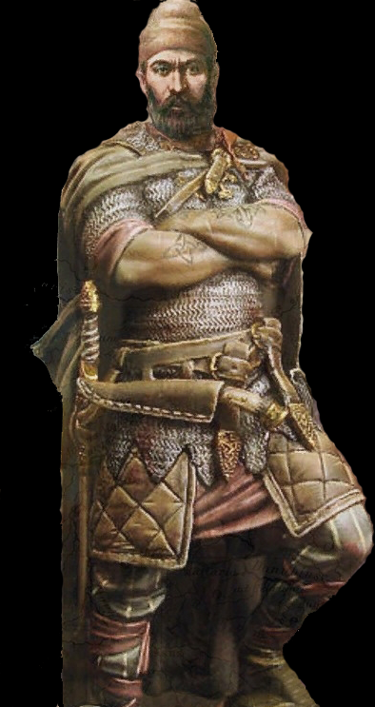
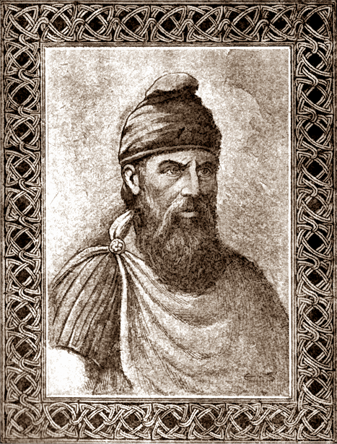
Romanian history
Romania has a very complex history.
Living in this territory since very ancient times, the Thracians created the bronze civilisation, being our ancestors.
The Roman colonization , then Byzantium defined the Latin and Christian origins of the Romanian people.
King
Decebal (87-106)
King
Burebista (82-44 before Christ)
Notes:
unfold

Slide 11
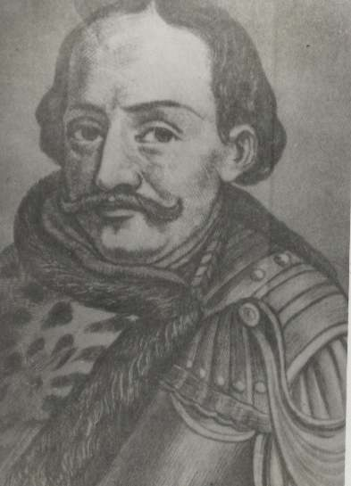
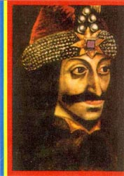
Middle Ages Romanian Kings
Mircea the Old
Iancu of Hunedoara
Stephan the Great
Vlad Dracula
Notes:
unfold

Slide 12
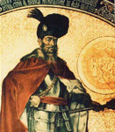
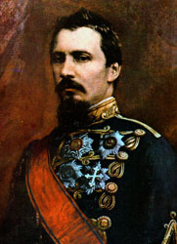
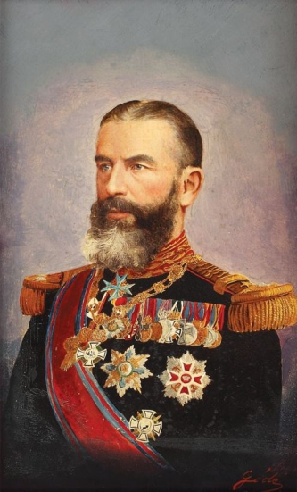
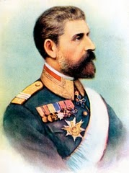
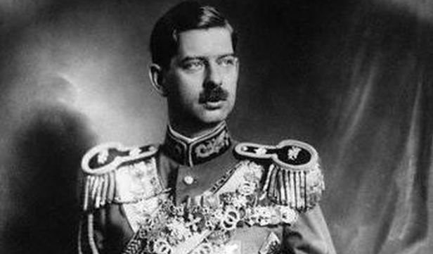
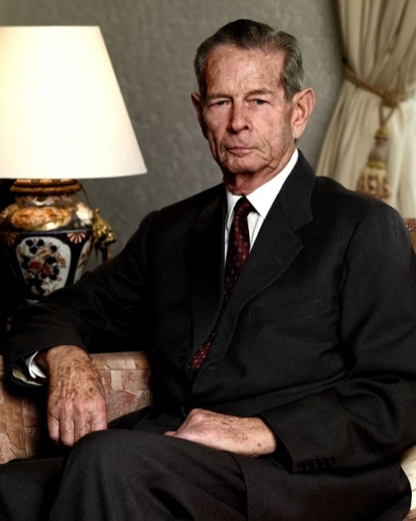
XVII th – XIX th Century Romanian Kings
Michael the Brave
Alexandru Ioan Cuza
King Carol of Hohenzollern
King Ferdinand
King Mihai
King Carol II

Slide 13
Geography
Romania is divided into 9 historical regions, Moldavia and Dobroudja in the East, Valachia and Oltenia in the south, Banat and Crisana in the west, Maramures and Bucovina in the north and Transylvania in the Centre.
But today there are 41 counties, called “judeţe” and the district of Bucharest, our capital.
Notes:
Big ttle

Slide 14
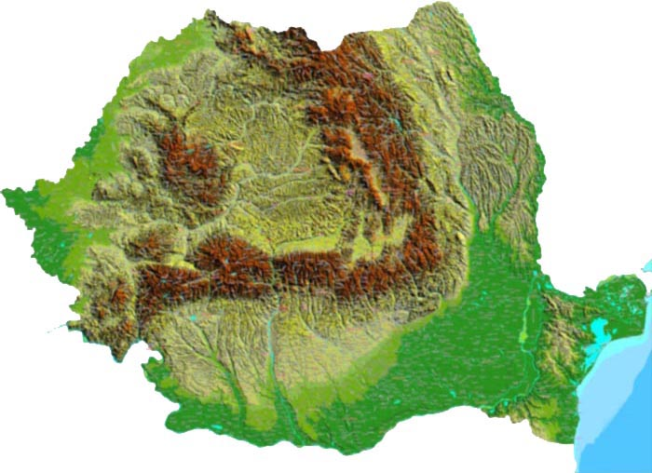
We can say that our country offers very different beautiful landscapes.
The Carpathians, the Danube and the Black Sea are three important characteristics of our relief.
Notes:
bounce

Slide 15
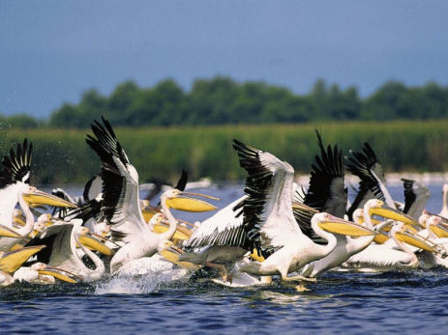
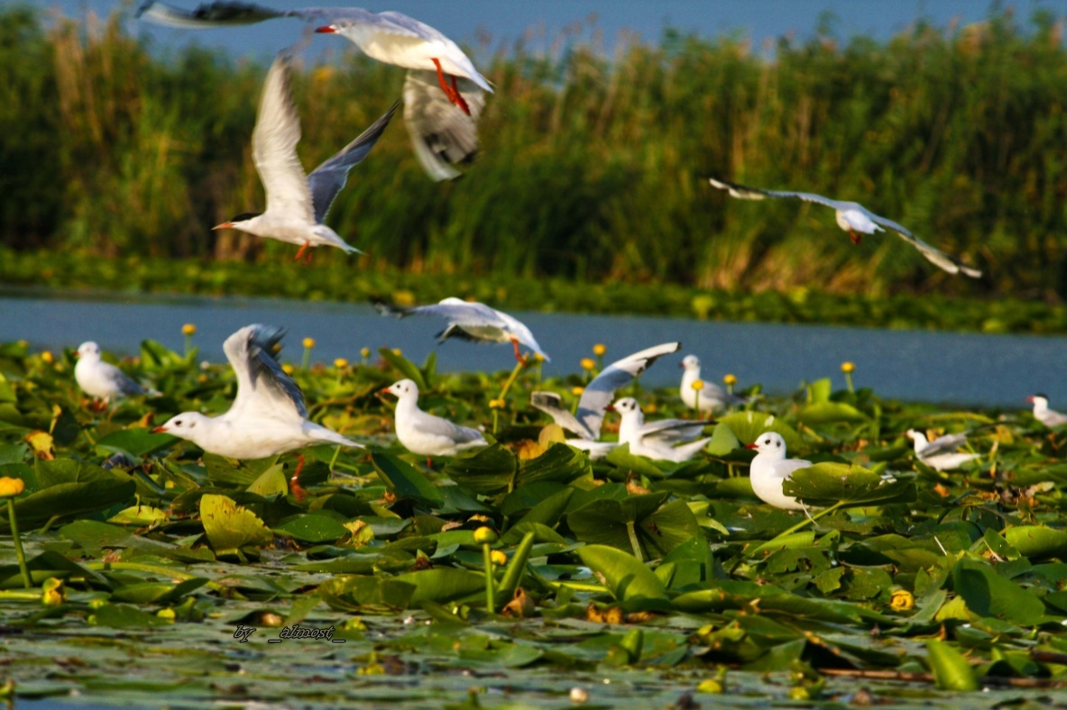
The Danube Delta is unique in Europe, through its landscapes, flora and fauna. It is declared biosphere reservation by UNESCO.
Notes:
bounce

Slide 16
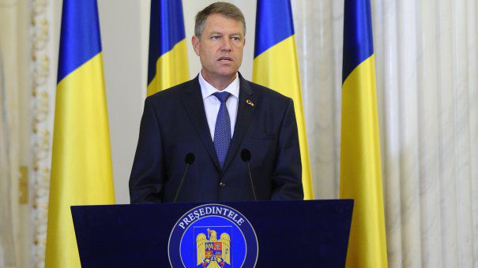
Politics
The 25th of April 2005, in Luxembourg, Romania signed the treaty of adhesion to the European Union, in order to become a member on 1st of January 2007.
President of Romania
Klaus Iohannis
Notes:
Elipse motion

Slide 17
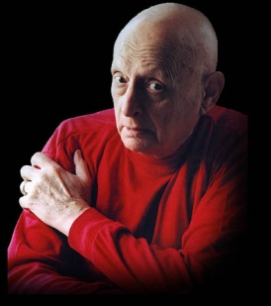
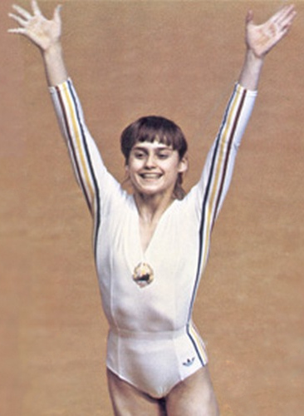
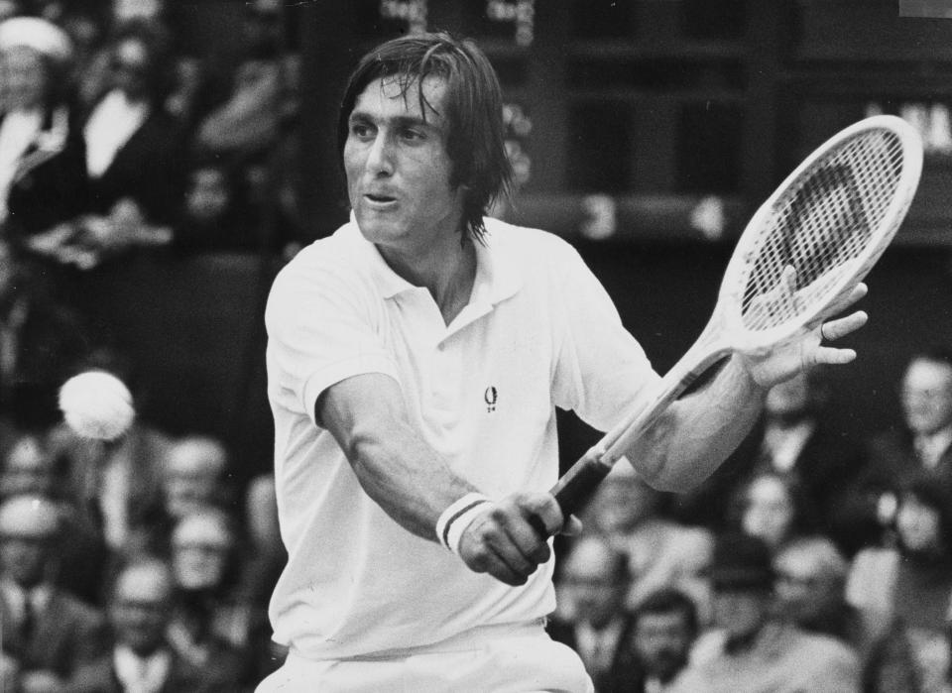
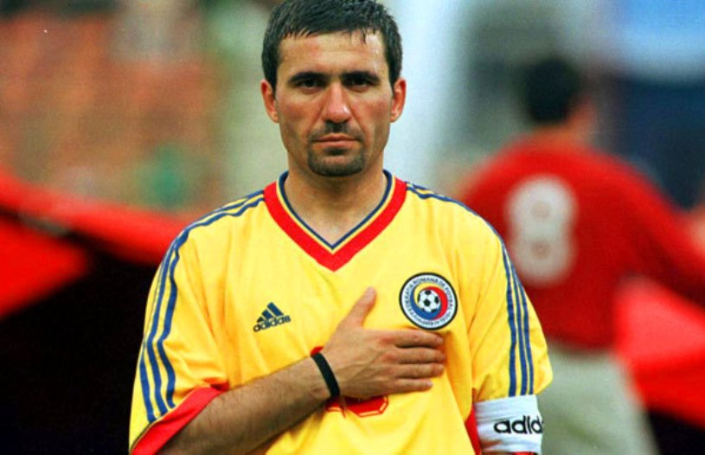
Famous personalities
Mihai Eminescu Constantin Brancusi Mircea Eliade Marcel Guguianu George Enescu
poet sculptor writer sculptor musician
Nadia Comaneci
gymnast
Ilie Nastase
tennis player
Gheorghe Hagi
footballer
Notes:
float

Slide 18
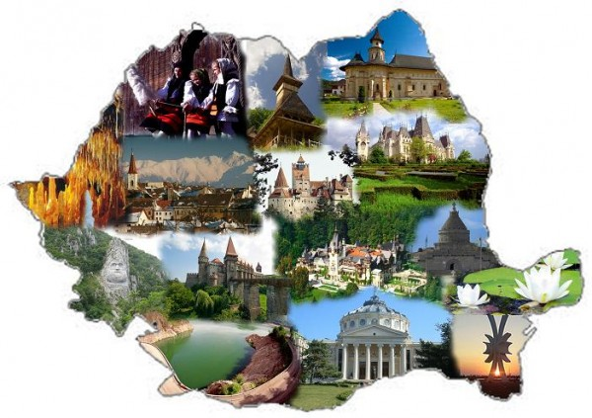
Romania- representative photos for each region
Notes:
float

Slide 19
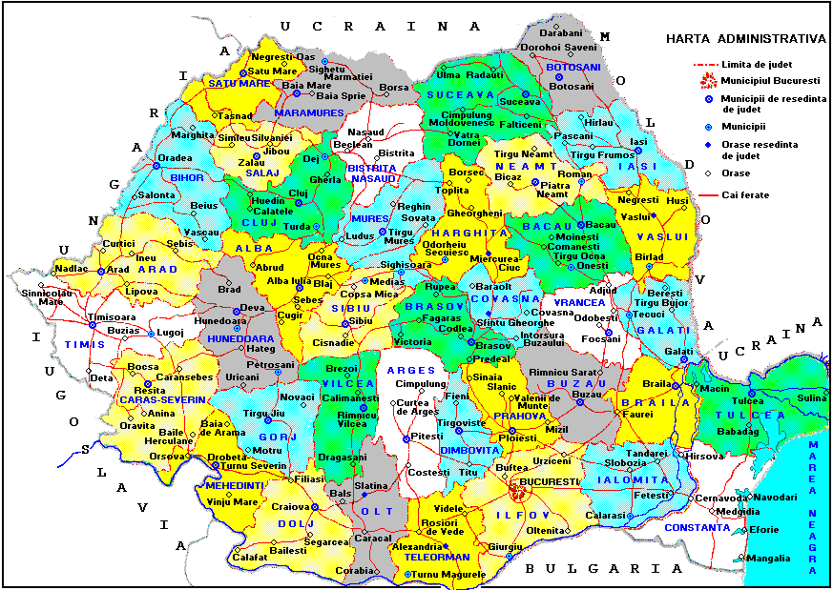
VASLUI – History
Vaslui was mentioned for the first time in the internal documents on March 31st 1423, during the reign of the king Alexander the Good, and in the external documents in 1375.
Vaslui

Slide 20
VASLUI – geography
Vaslui is a North – Eastern County of Romania, situated in Moldavia, having a surface of 5,318 km² and 500,000 inhabitants. The residence town is Vaslui, with 100,000 inhabitants.
Notes:
Title arc

Slide 21
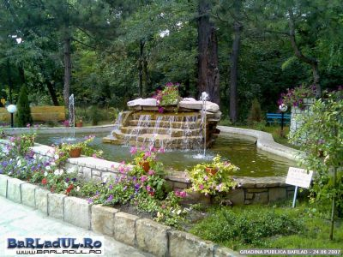
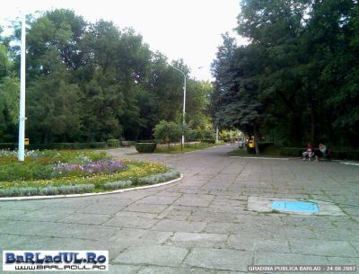
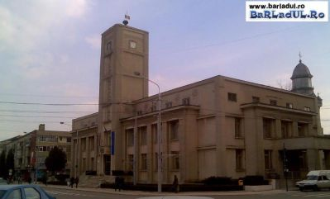
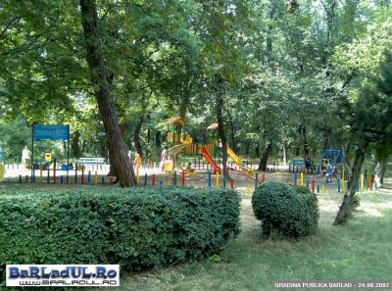
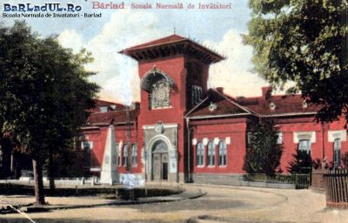
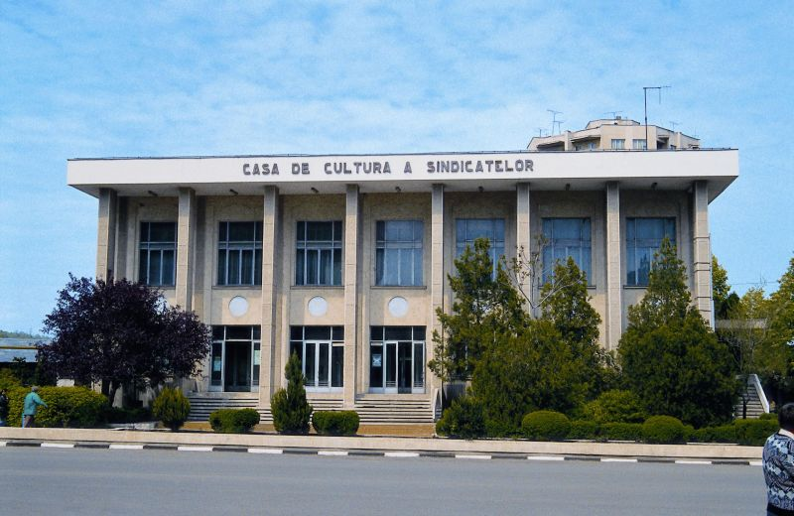
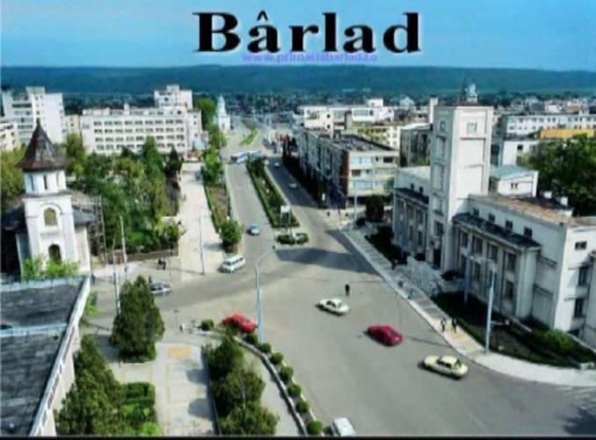
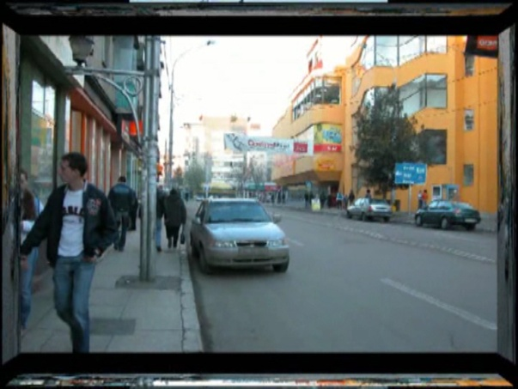
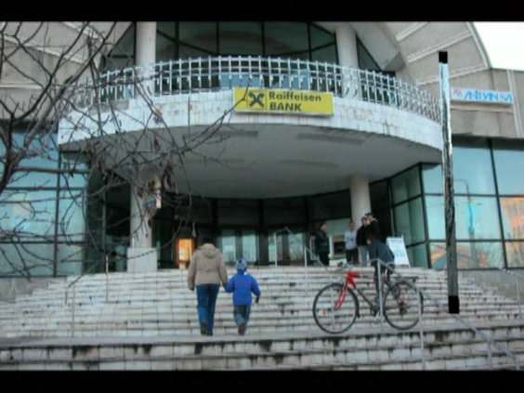
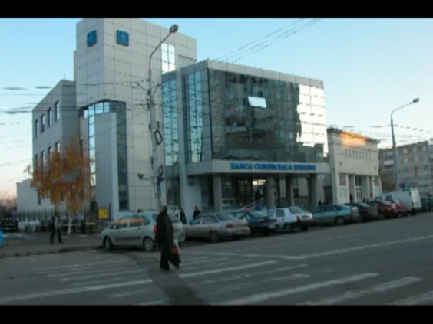
BÂRLAD TOWN

Slide 22
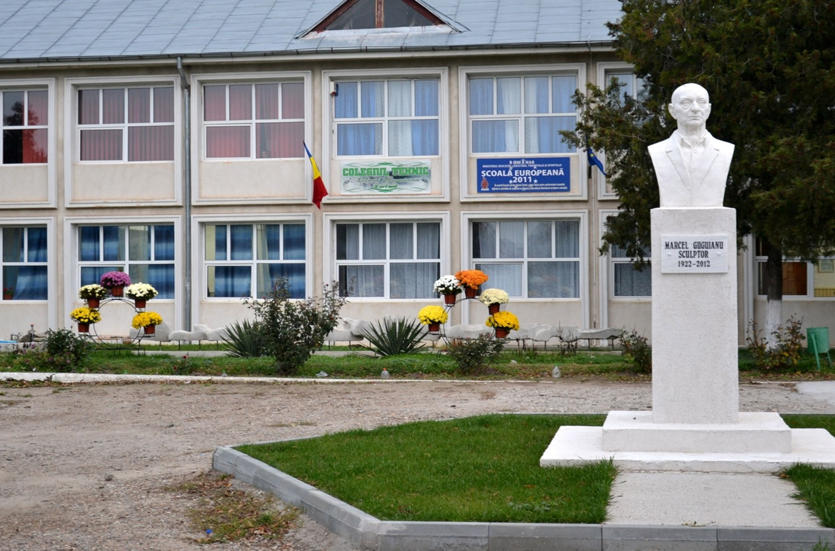
TECHNICAL COLLEGE
”MARCEL GUGUIANU”
ZORLENI -VASLUI COUNTY - ROMANIA

Slide 23
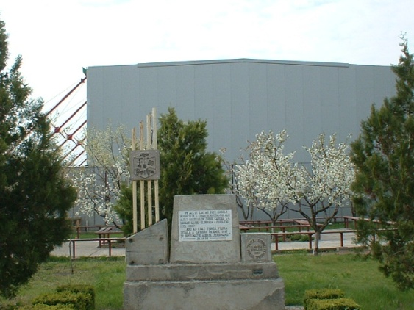
WHO ARE WE?
”Marcel Guguianu” Technical College from Zorleni follows the tradition of ”The County Crafts School” from Barlad, founded in December 19, 1881.
Starting from the autumn of the year 1977 it is turned into The Agricultural-Industrial High-school, and in 1991 into The Agricultural School Group Zorleni.
Since September 2002, it bears the name of the graphic artist and sculptor, Marcel Guguianu, former student and teacher of our school.

Slide 24
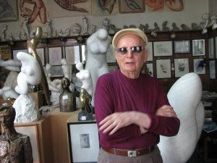
WHY GUGUIANU?
Because he was a student and teacher of The School of Arts and Crafts, whose traditon is followed by „Marcel Guguianu” Technical College;
Because he is one of the greatest Romanian sculptors and also one of world’s;
Because he promoted the idea that every young man should know a craft;
Because he supported both materially and spiritually our school;
Because he promoted the image of our school in the country and abroad;
Because he permanently inspired us to love the BEAUTY

Slide 25
„Marcel Guguianu” Technical College is 6 km far from Barlad, Vaslui county, in a village called Zorleni.
Our school has 726 students of which 298 are high school students (aged between 15 and 19 years old), studying Technical Profiles, Food Industry, Economics. The other 101 attend the Professional School, studying Mechanics. We also have 327 adult-students attending part-time courses. Our students study two foreign languages: English and Spanish.
Our human resources consist of 35 teachers, 10 auxiliary staff and 10 non-teaching staff. Our school has 3 buildings with 22 classrooms, laboratories, 2 computer labs, 1 gym, 1 library, 6 theoretical and technical workshops and a self-service shop.
.

Slide 26
WHAT DOES OUR SCHOOL OFFER?
Specialised and qualified didactic staff
Learning spaces adequately equipped
- 22 classrooms;
- 2 IT laboratories, 1 Chemistry lab;
- 8 offices;
- 6 workshops;
a gym;
a Documentary & Information Center.
Extra-curricular activities:
- Erasmus+ projects
- Educational projects
-„Adolescenţa” Radio Station
- Volunteering activities
- Modern dance and theatre groups
Sport teams
Driving school (B and Tr cathegories)

Slide 27
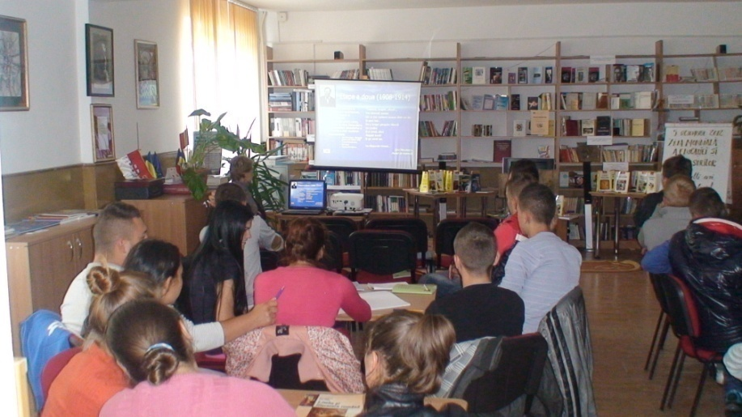
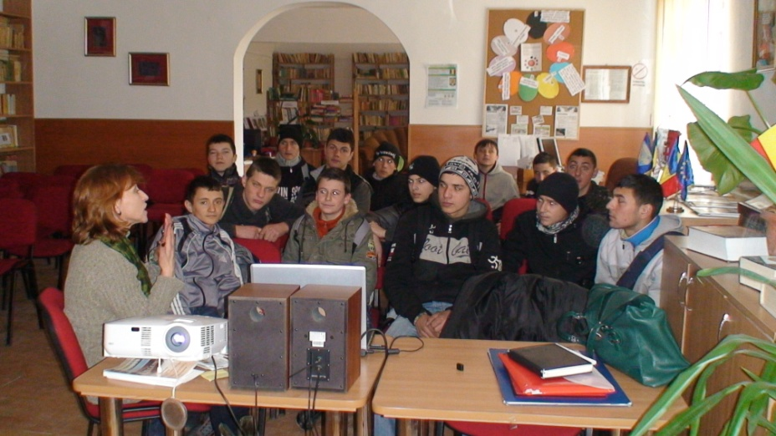
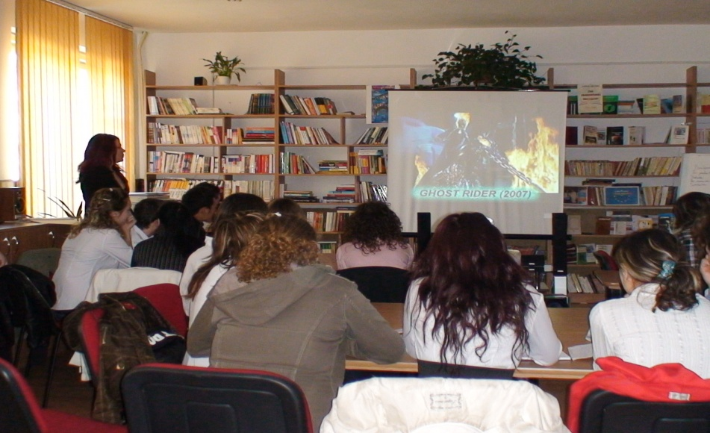
Interactive lessons- at the Documentation and Information Center

Slide 28
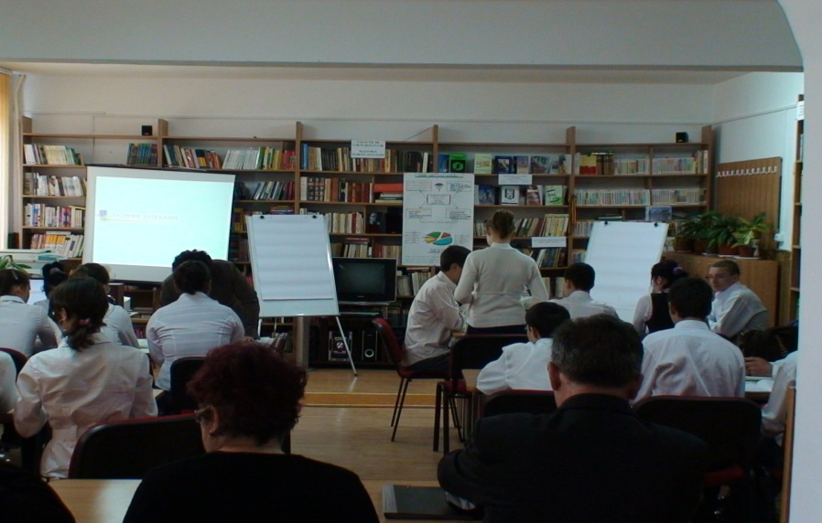
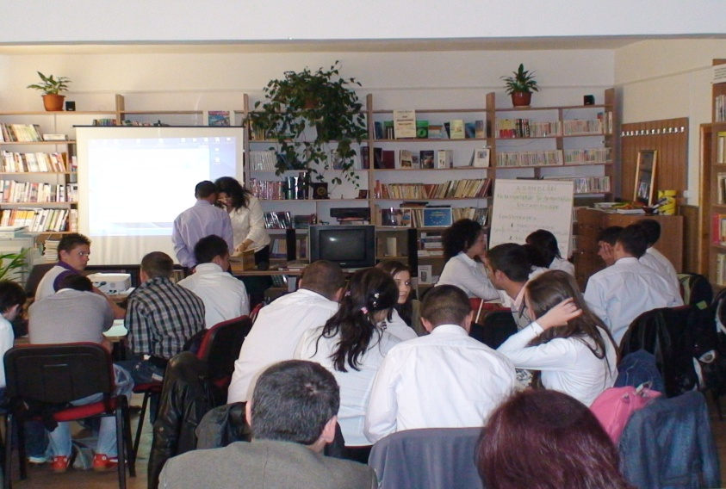
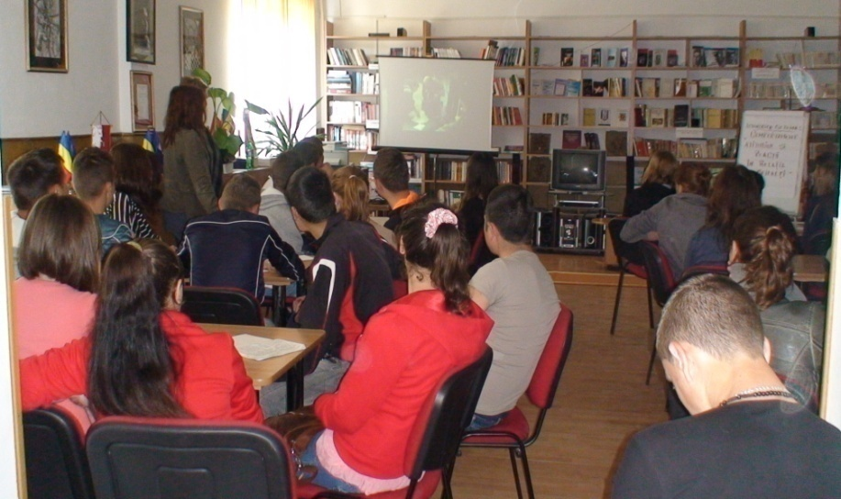
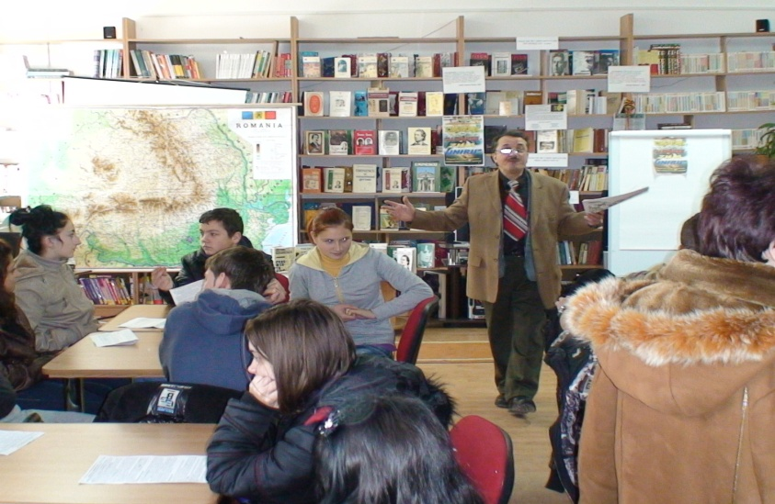
Interactive lessons- at the Documentation and Information Center

Slide 29
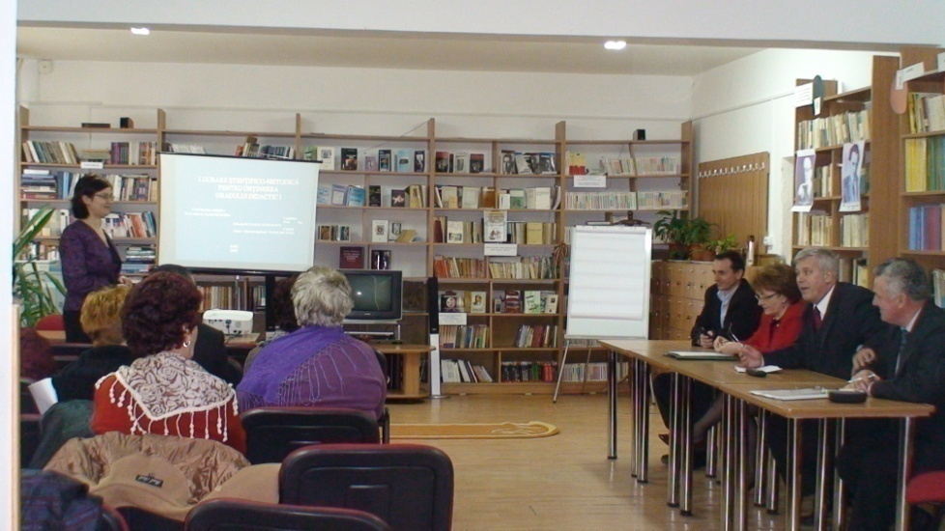
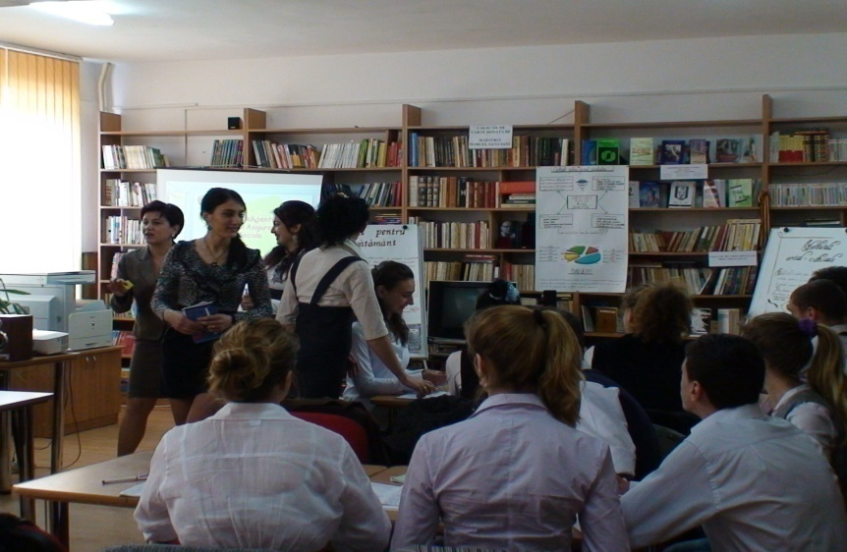
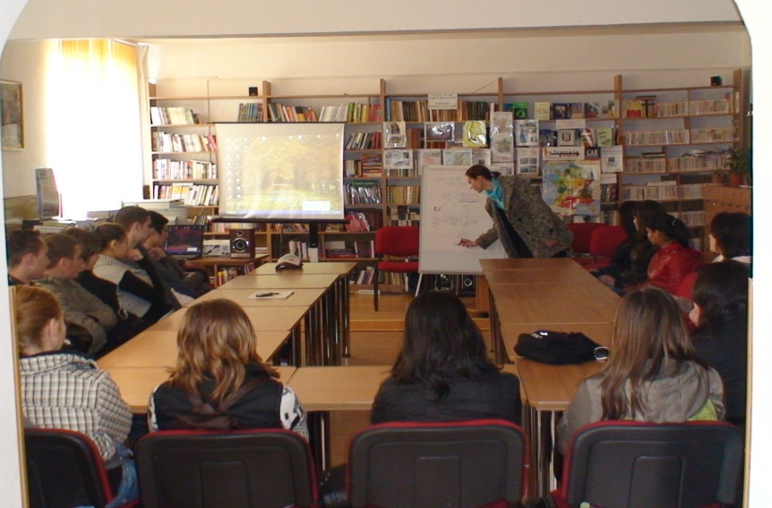
Interactive lessons- at the Documentation and Information Center

Slide 30
Extra-curricular activities

Slide 33
European projects carried on by our school
PHARE-TVET - PHARE RO. 0108.01, PHARE RO. 0108.03
LINGUISTIC PROJECT – “Architecture du paysage – projection dans l’art francais des espaces verts” (2003-2004)
PHARE PROJECT FOR HUMAN RESOURCES DEVELOPMENT – “Promoting the antrepreneurism for creating new workplaces” (2004-2005) PHARE PROJECT FOR HUMAN RESOURCES DEVELOPMENT- “The Training of 78 unemployed perrsons at the job of Commercial worker” (2005-2006)
SOCRATES LINGUISTIC PROJECT – “Conservation des Especes Essentielles des Ecosystemes dans les Reserves Naturelles” (2006-2007)
SOCRATES PROJECT FOR SCHOOL DEVELOPMENT – “History, Societies and Education“ (2006-2007)
GRANT PROJECT FOR SCHOOL DEVELOPMENT – “Technology and Art for a Friendly Scool through Extracurricular Activities“ (2007-2008)
Three titles of “EUROPEAN SCHOOL“ - PROJECT – starting with the 2008 edition
THE 2000+ TEACHER, A TEACHER FOR TOMORROW (2008-2009)
COMENIUS PROJECT - BILATERAL PARTNERSHIP – “Agricultural and Environmental English” ( 2008-2010)
COMENIUS PROJECT MULTILATERAL PARTNERSHIP - “Teaching and Learning in Natural Parks“ (2009-2011)
Developing Parental Skills – Grundtvig project (2011-2013)
MULTIPLE INTELLIGENCES IN LANGUAGE LEARNING - Comenius project (2011-2013)
Bullying and media – Comenius project (2012-2014)
Career asistance & spirit of enterprise Grundtvig project (2013-2015)
Team Up & Reform Netizens - Outdoor Fantastic Fun TURN OFF – Erasmus+ / KA2 (2017-2019).
OUR DAILY BREAD – Erasmus+ / KA2 (2017-2020).
O SCOALA CU O USA CATRE LUME– Erasmus+ / KA1 (2017-2018).

Slide 34
Romania

Slide 35
Thank you for your attention !

