Slide 1
Our trip to incredible places in romania

Slide 2
We visited and enjoyed:
National Park Bicaz
Piatra Neamt
Cozla Park
Bistrita Monastery
Izvorul Muntelui
Bicaz Dam
Cheile Bicazului
Lacul Rosu

Slide 6
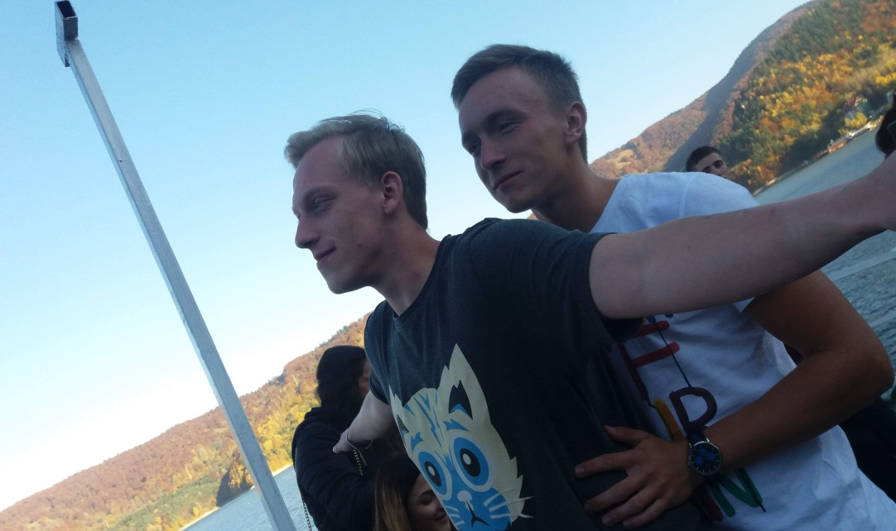

Slide 7
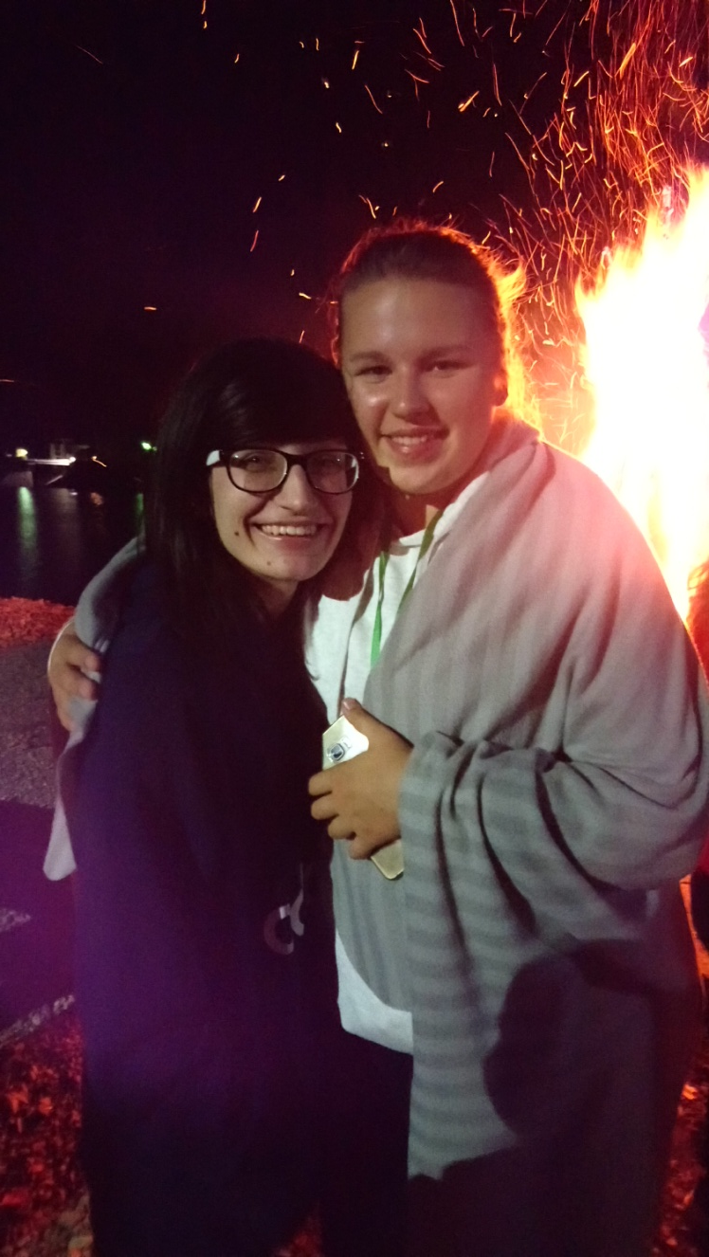

Slide 8
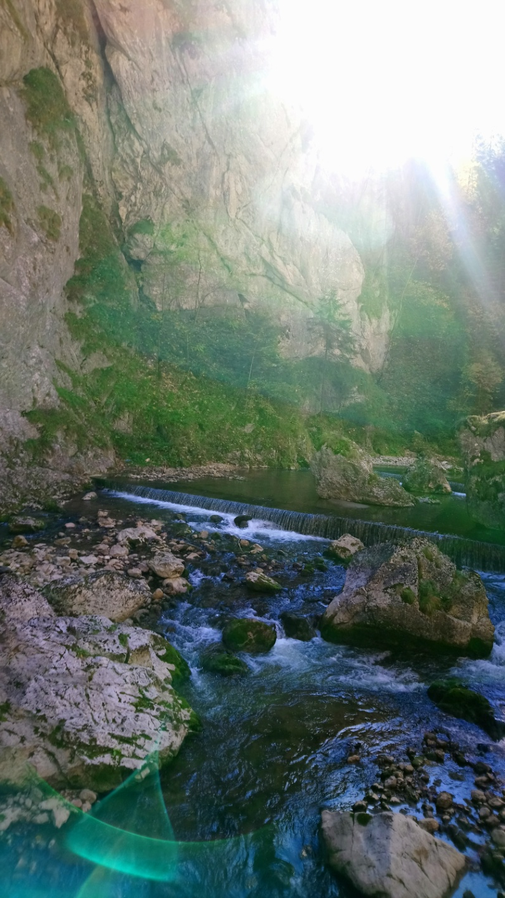

Slide 9
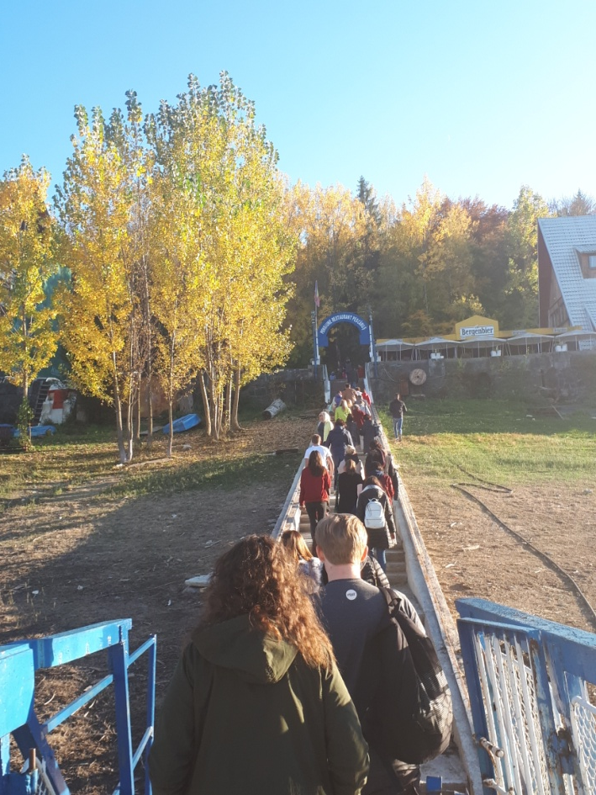

Slide 10
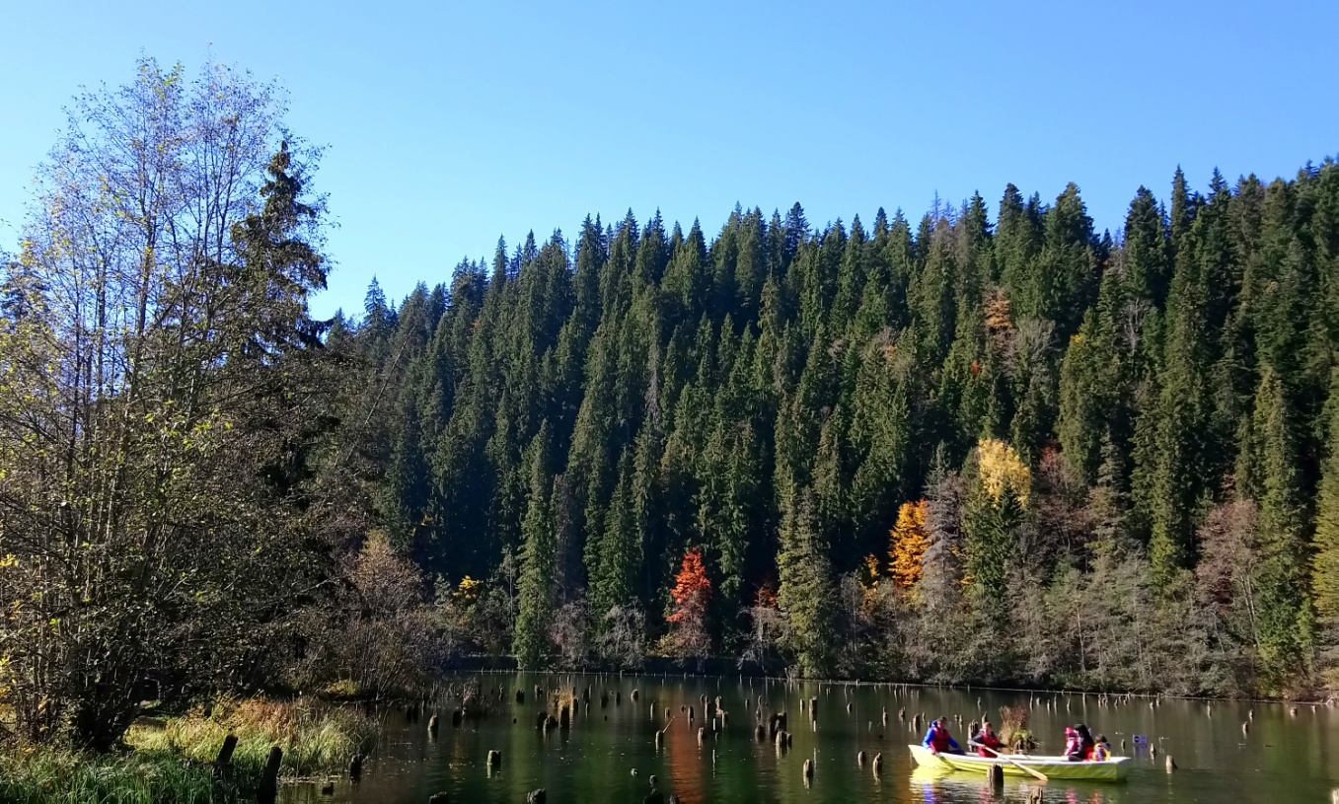

Slide 11
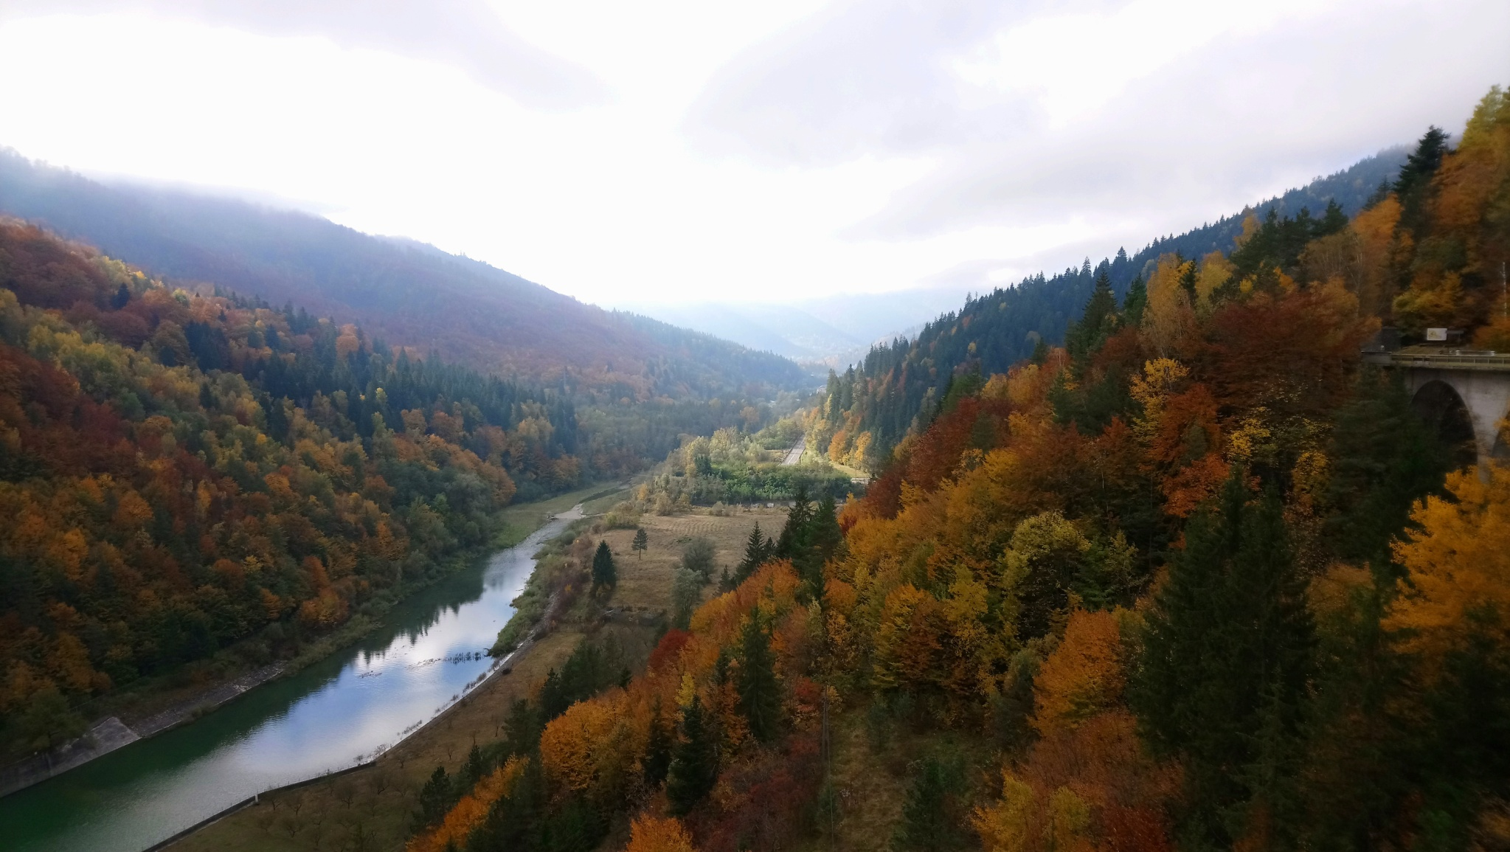

Slide 12
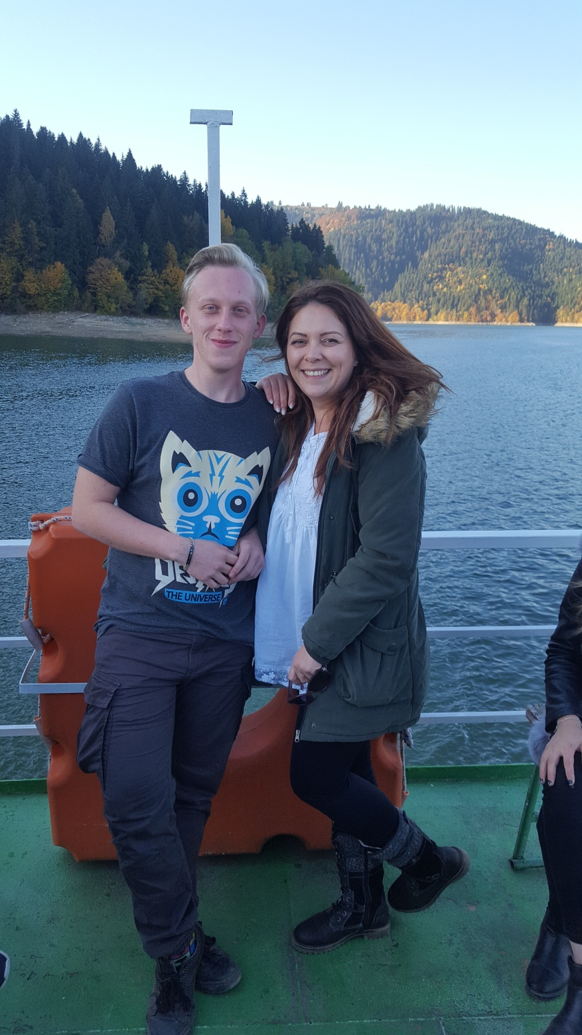

Slide 15
It was a great time with all people from Romania, Belgium and Latvia ☺

