Slide 1
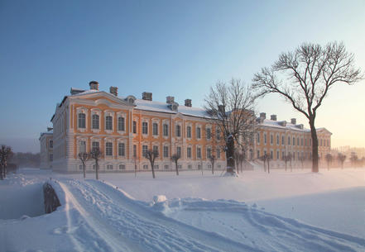
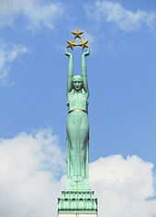
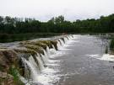
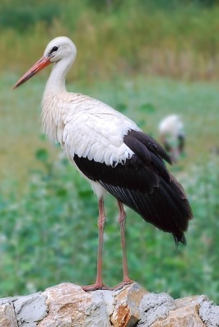
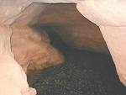
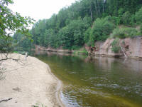
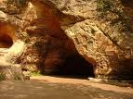
Welcome to My Country
Notes:
1
Welcome to my country, as you saw in video we have dense, sprauling forests which covers about 50% of territory,
12,400 rivers, the longest one is River Gauja, 452km,
2256 lakes(lager than 1ha),
Our border line is 1836km and we have border with Estonia, Lithuania, Russia and Belorussia
Sea shore 498km
And about 1,9 million habitants

Slide 2
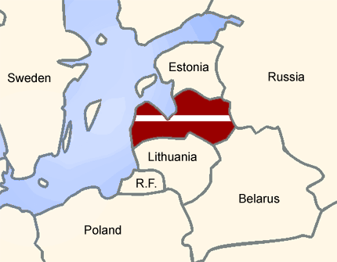
Latvia is a country at the Baltic Sea between Lithuania and Estonia.
Notes:
2
Latvia is a country at the Baltic Sea between Lithuania and Estonia

Slide 3
Latvia
Latvia has one of the oldest flags in the world,
first mentioned in documents in 1209
Notes:
3
Latvia has one of the oldest flags in the world, first mentioned in documents in 1209
3

Slide 4
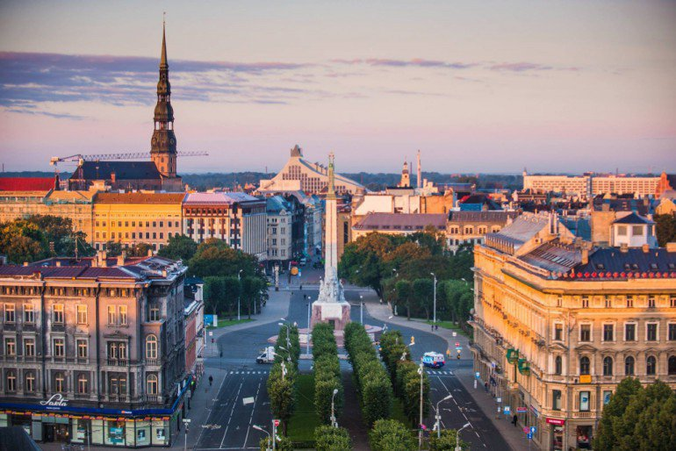
Latvia’s capital is Riga,
and there live a half of Latvian population
Notes:
4
Latvia's capital is Riga, and there live a half of Latvian population

Slide 5
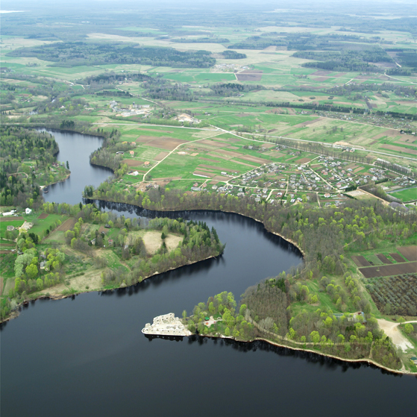
Territory of Latvia covers
64,589 km²
45% forests
Notes:
5
Territory of Latvia covers 64,589 km2 and we have about 45% of forests

Slide 6
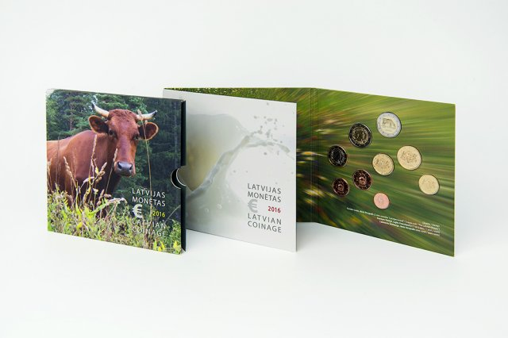
Since January 1st, 2014,
the official currency of Latvia is the Euro.
Notes:
6
Since January 1st, 2014, the official currency of Latvia is the Euro

Slide 7
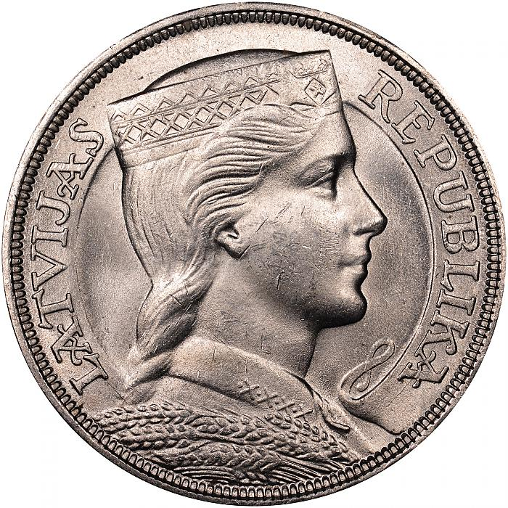
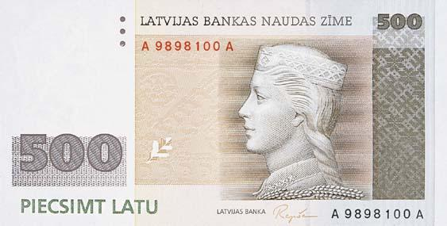
Our currency before Euro were Lats,
and maiden on it we call Milda,
she is the symbol of Latvian freedom
Notes:
7
Our currency before Euro were Lats, and maiden on it we call Milda, she is the symbol of Latvian freedom

Slide 8
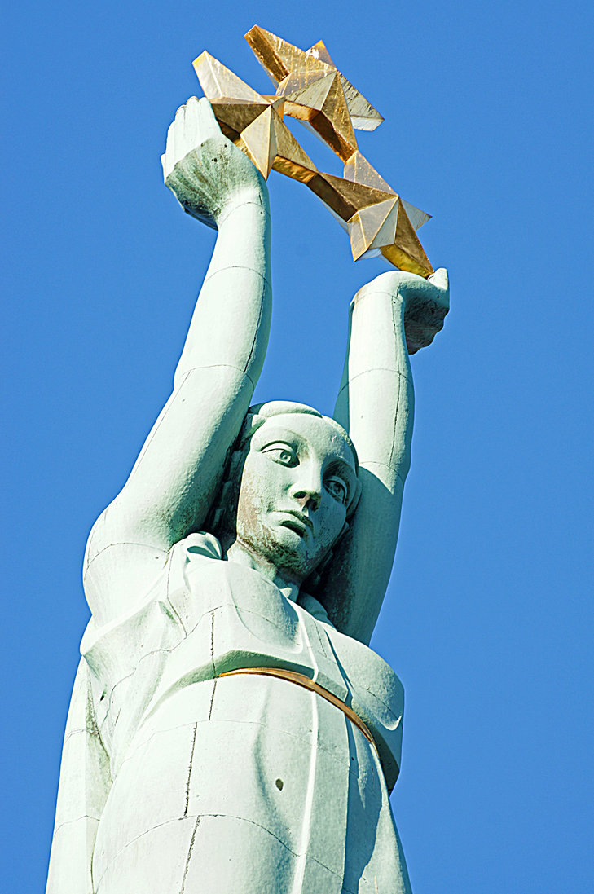
Another symbol
of freedom
- Latvia's
Statue of Liberty
Notes:
8
Another symbol of freedom – Latvia's Statue of Liberty

Slide 9
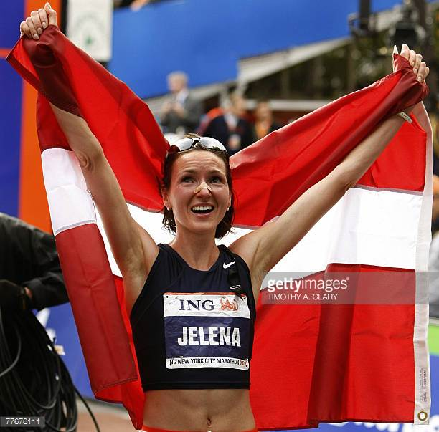
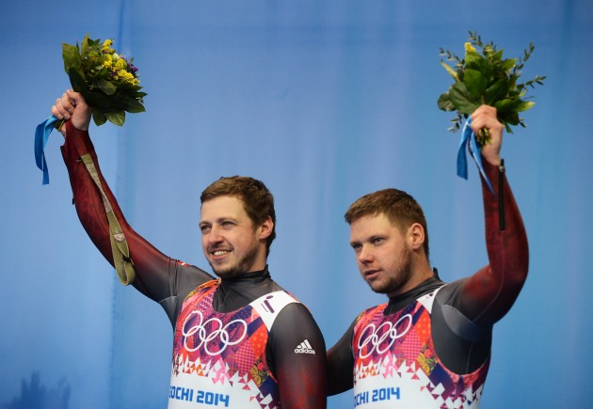
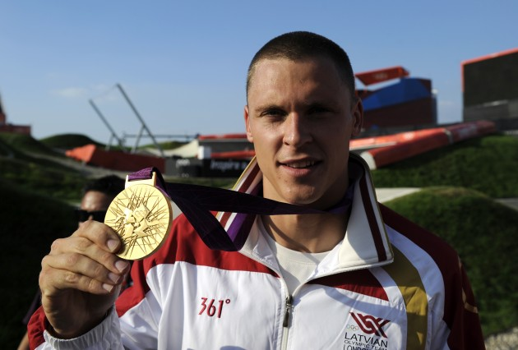
We are proud of our Latvian sportsmen and athletes
Notes:
9
We are proud of our Latvian sportsmen and athlets – Rebeka Koha – weightlifter, Jelena Prokopčuka athlet and marathon runner, Brothers Andris and Juris Šics – luge, Māris Štrombergs – BMX ride

Slide 10
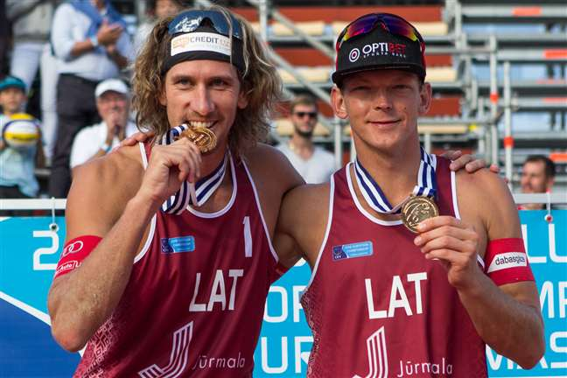
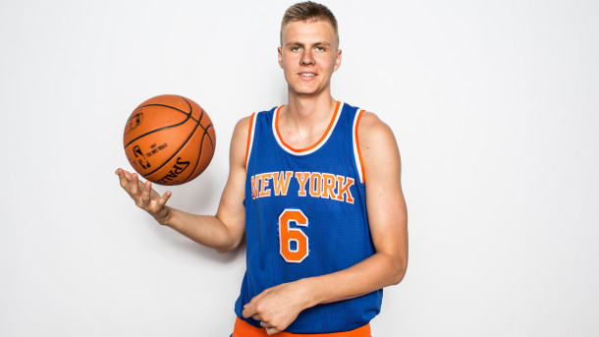
Notes:
10
Jānis Šmēdiņš and Aleksandrs Somoilovs - beach volley, Kristaps Porziņģis – basketball player, Anastasija Grigorjeva – freestyle wrestling

Slide 11
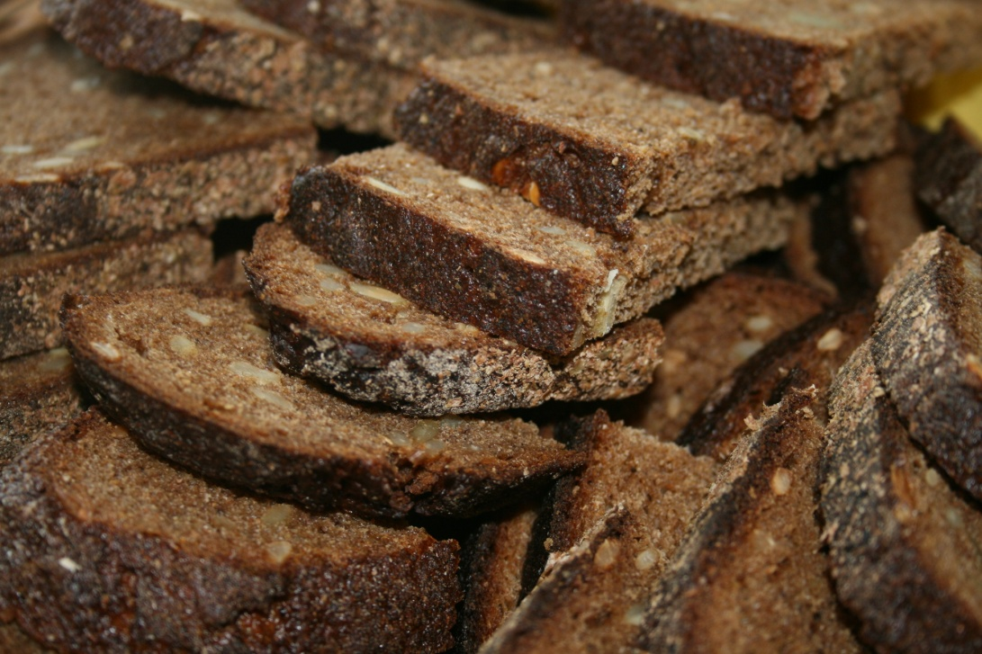
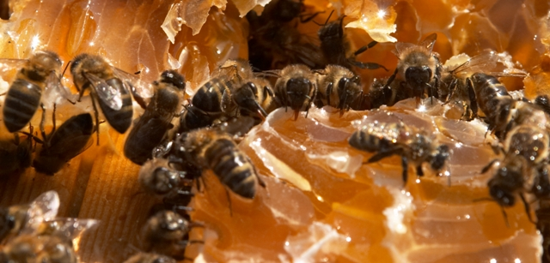
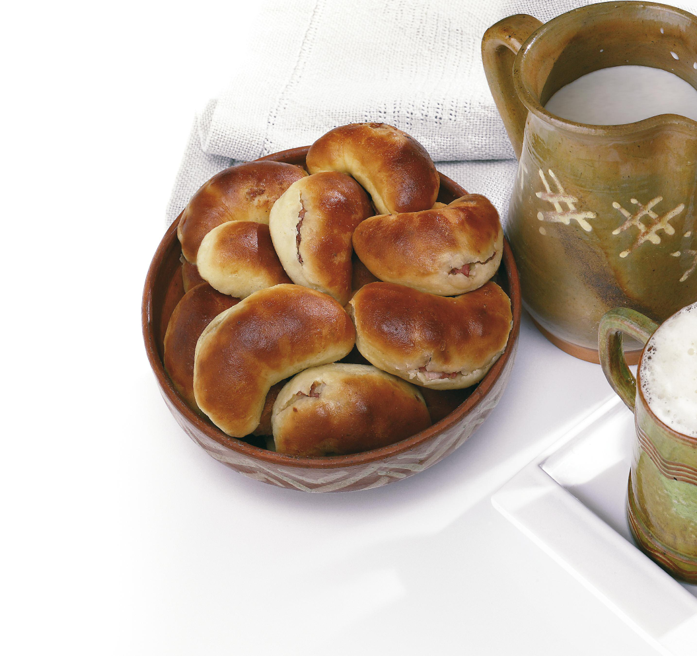
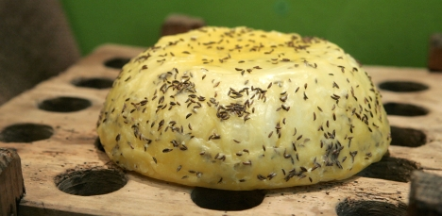
Notes:
11
Latvian traditional food – rye bread, honey, cheese with cumins, and speķpīrāgs or bread roll filled with chopped bacon cubes and onion

Slide 12
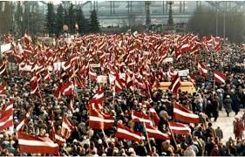
We celebrate
Latvia's Independence Day - 18th November
Notes:
12
Celebrations – we celebrate Latvia’s Independence Day on the 18th of November

Slide 13
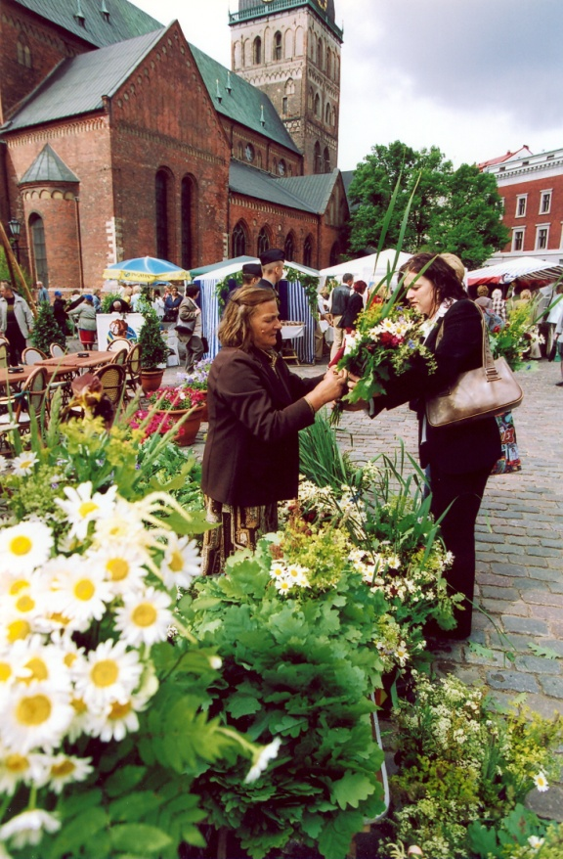
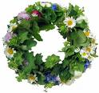
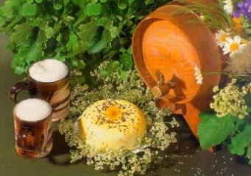
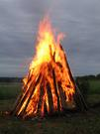
Jāņi - Summer solstice celebration
Jāņi is one of the oldest and most popular tradition in Latvia
Notes:
13
Jāņi – Summer solstice celebration. Jāņi is one of the oldest and most popular tradition in Latvia

Slide 14
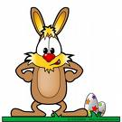
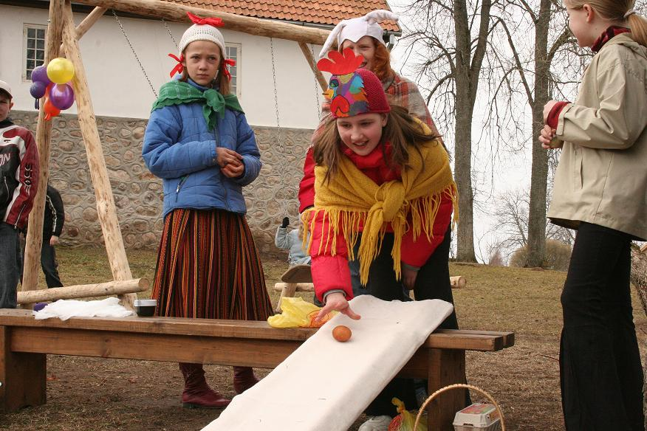
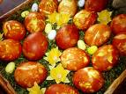
Spring solstice/
Easter
Notes:
14
Spring solstice/Easter

Slide 15
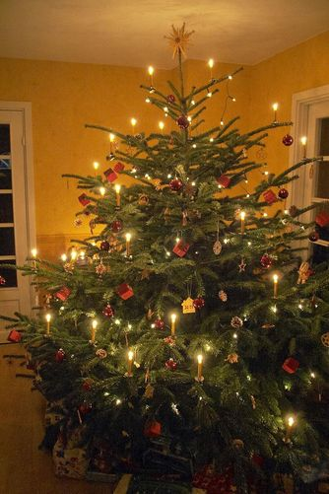
Winter Solstice/ Christmas
The Capital of Christmas
tree
is Riga,
because the first ever
Christmas tree
was set-up and
decorated in
Riga's market square
in 1510.
Notes:
15

Slide 16
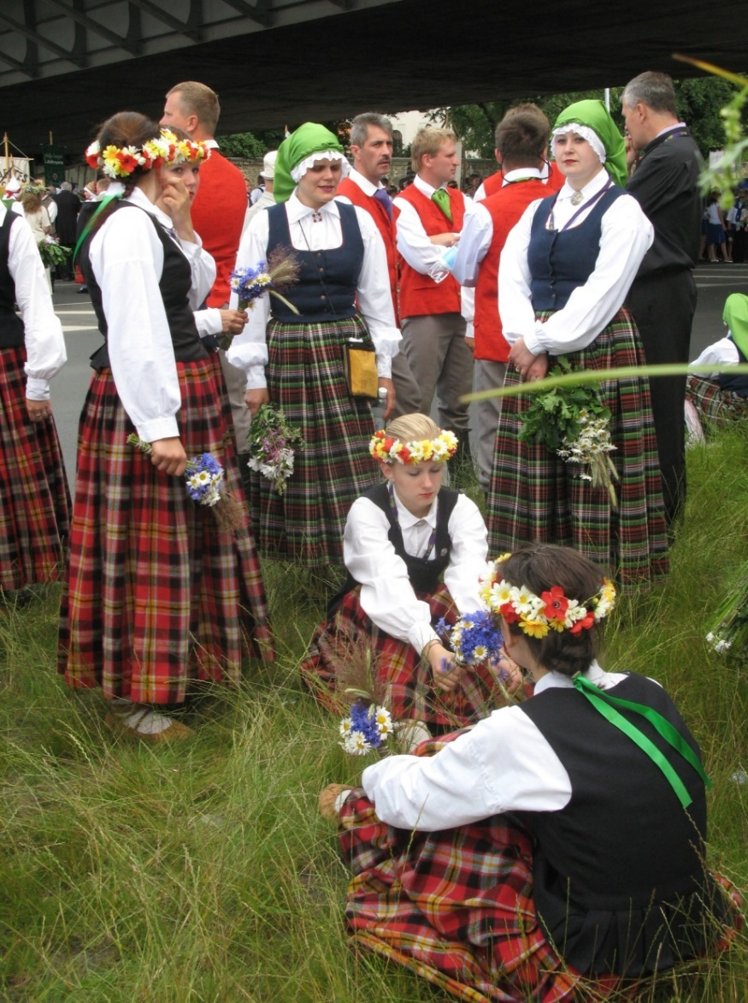
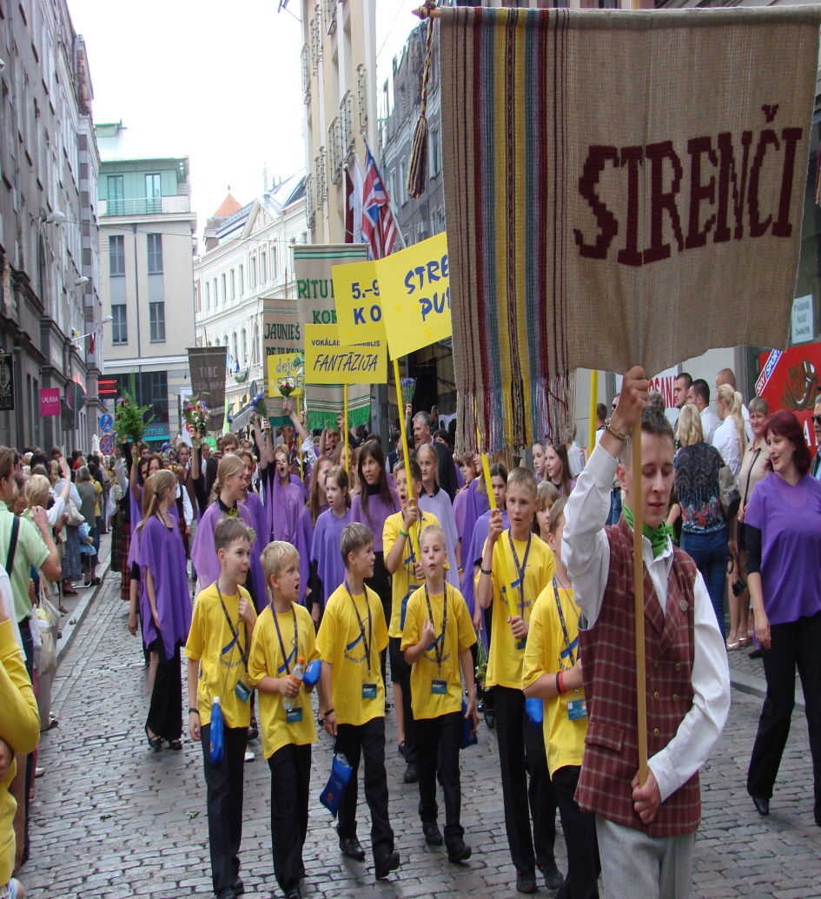
Song and Dance Festival
Notes:
16
We participate in the biggest event in Latvia – Song and Dance Festival every 5 years

Slide 17
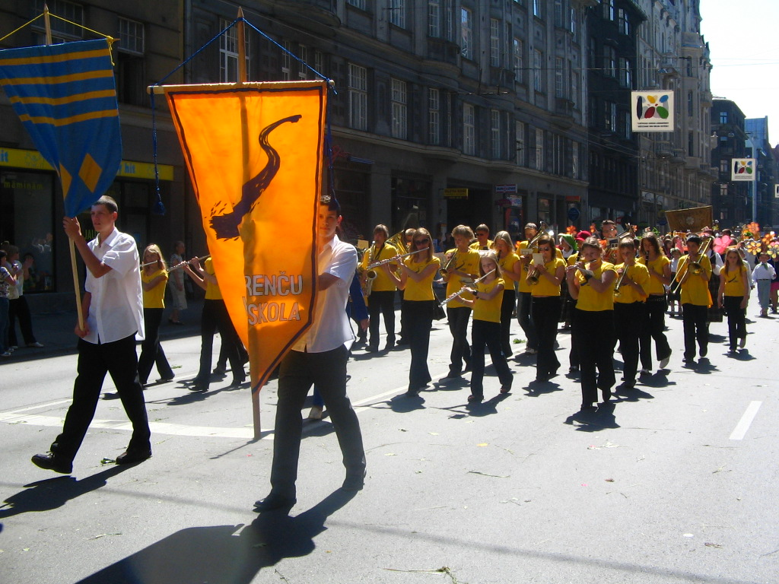
Song and Dance Festival
Notes:
17

Slide 18
Song and Dance Festival
Notes:
18

Slide 19
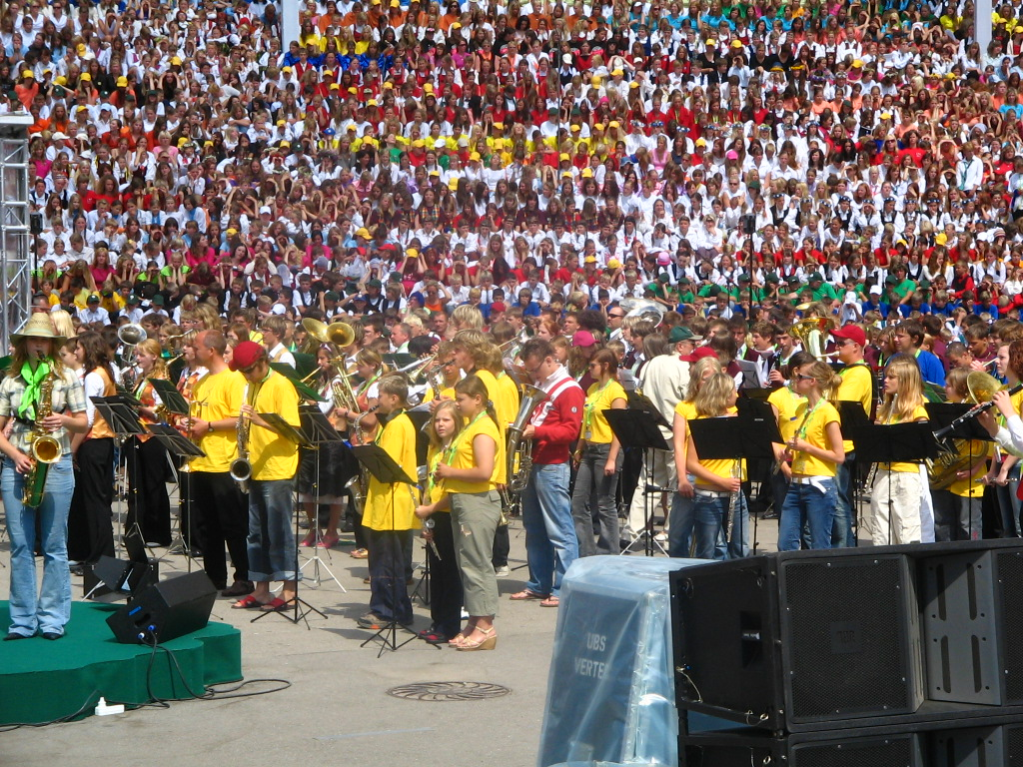
Song and Dance Festival
Notes:
19

Slide 20
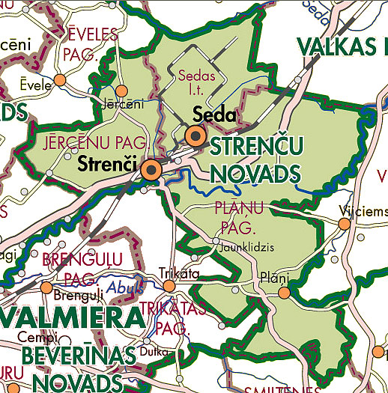
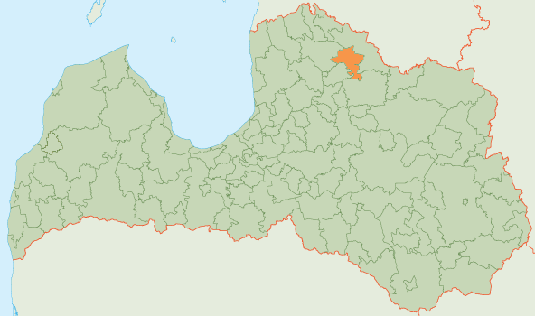
Strenči County
Notes:
20
We live in Strenči County, Strenči

Slide 21
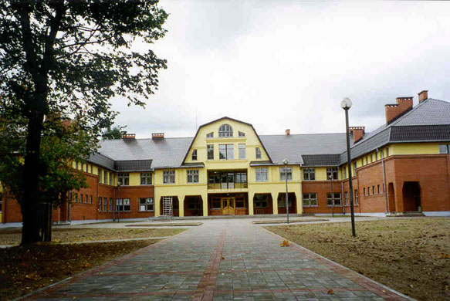
STRENČI COUNTY'S SECONDARY SCHOOL
LATVIA
Notes:
21
We attend Strenči County’s Secondary school

Slide 22
STRENČI COUNTY'S SECONDARY SCHOOL
Way of Life, way of River,
May be place where thirsty can get a knowledge...
Facts:
- first school in Strenči from 1909
- today 154(1st to 12th grades) pupils and 30 teachers
Notes:
22
Our schools Moto is: Way of Life, way of River, May be place where thirsty can get a knowledge...
Facts: - first school in Strenči was built in1909, - today 154(1st to 12th grades) pupils and 30 teachers

Slide 23
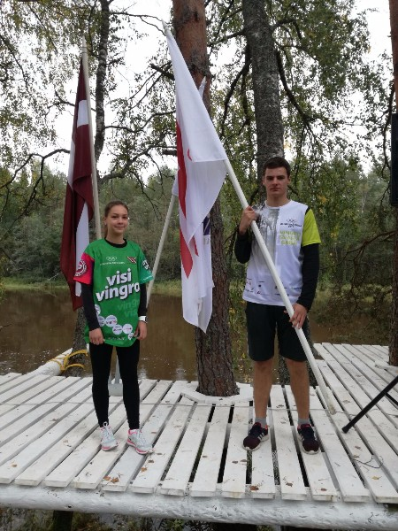
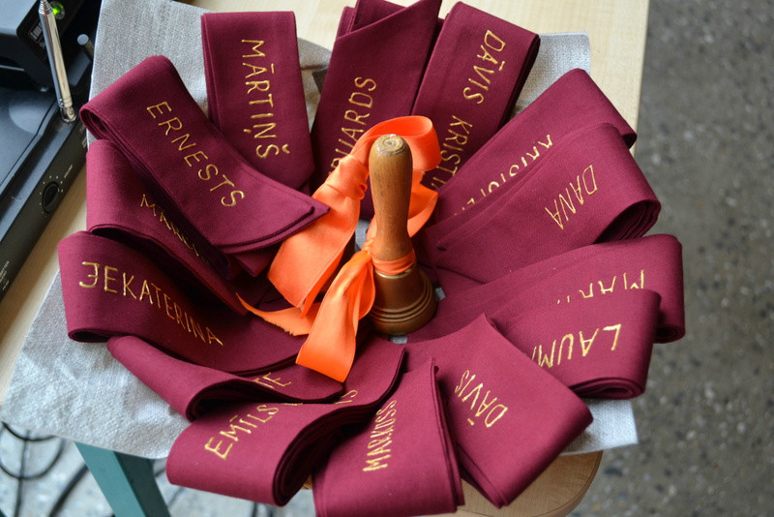
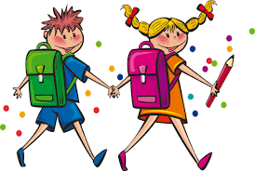
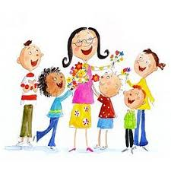
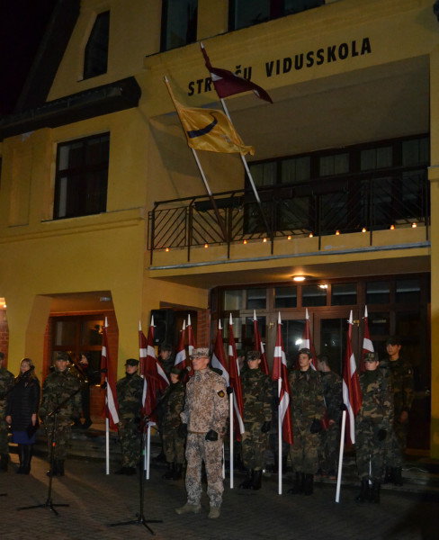
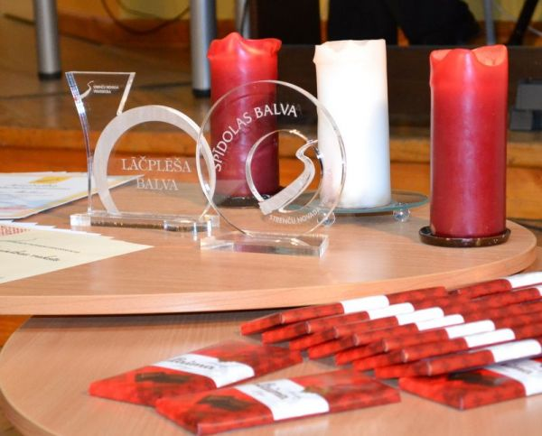
STRENČI COUNTY'S SECONDARY SCHOOL
Traditions
Notes:
23

Slide 24
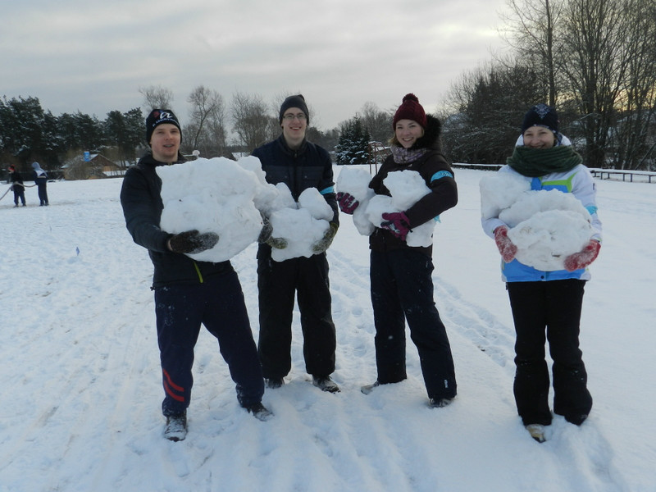
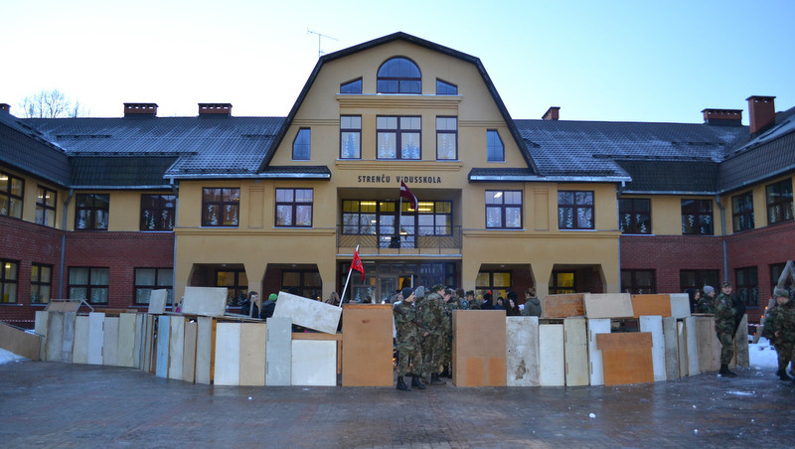
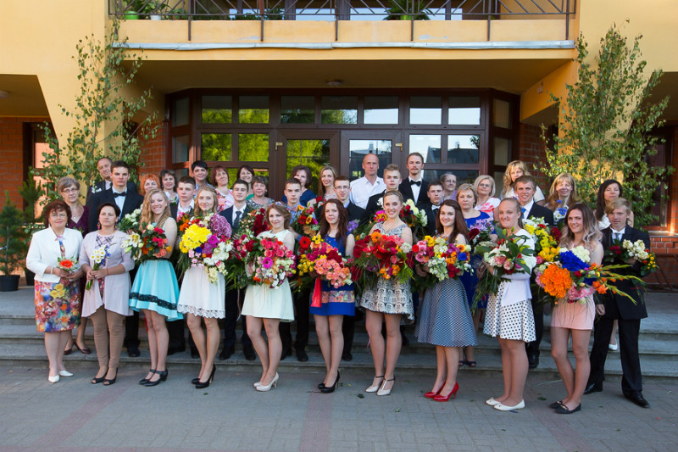
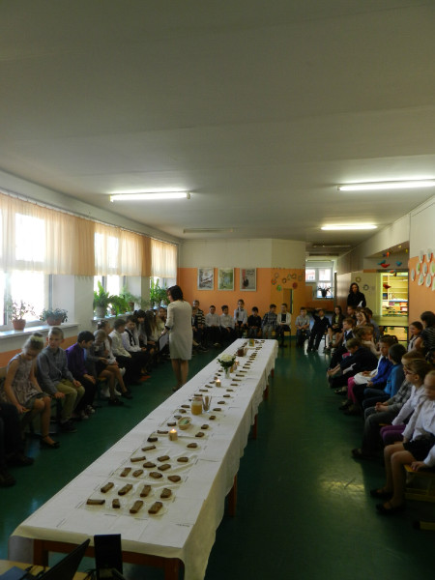
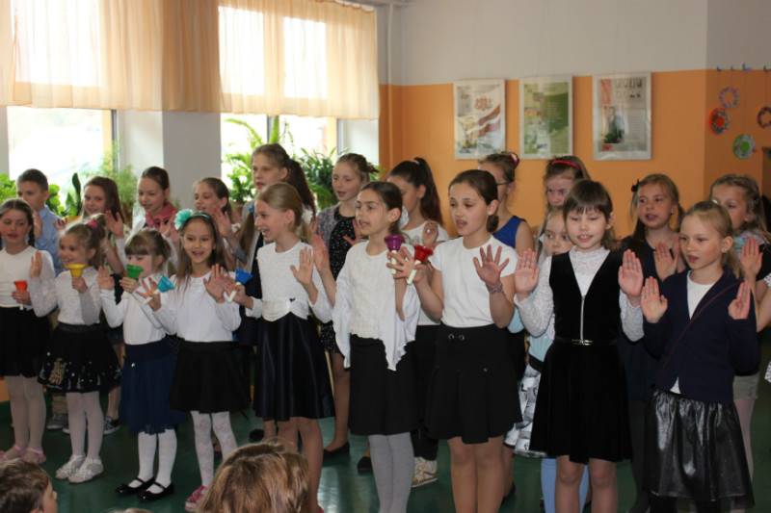
Notes:
24
In winter – The Worlds Snow Day, the 20th January – Remembrance Day of Barricades, 4th May Independence Declaration Day, Mother’s Day, The Last Lesson’s Day and Graduation’s Party.

Slide 25
We play volleyball and football, dance Folk-dances,
sing in a choir, play in Orchestra,
participate in Youth Guard
Notes:
25
We play volleyball, dance Folk-dances, sing in a choir, play in Orchestra, participate in Youth Guard

Slide 26
Welcome to Strenči!
Notes:
26

